Slide 1
Directed study review
Read another reading from the folder on interviewing
Make approaches to the five names on your interviewee list
Brainstorm the questions you will ask & shortlist the best
Conduct an interview — for story or for practice

Slide 2

Drafting fast: the first cut
Paul Bradshaw

Slide 3
By next week you should be able to:
Organise your raw material into parts of a story
Identify typical story structures you can use
Explain how genre shapes the structure you choose

Slide 4
How structures can help you write quicker, better

Slide 5
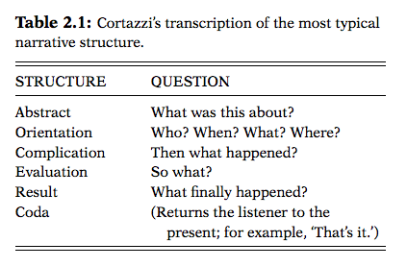
Martin Cortazzi 1993
Notes:
Analysed plots from Wikipedia

Slide 6
For example: nursery rhyme
1. Jack and Jill went up the hill (abstract)
2. To fetch a pail of water (orientation)
3. Jack fell down (complication)
4. And broke his crown (evaluation)
5. And Jill came tumbling after (result)
(no coda?)

Slide 7
For example: documentary
1. “The rhino is one of the rarest animals (abstract)
2. “CDY National Park is situated... (orientation)
3. “Poachers are hunting the rhinos (complication)
4. “The police are trying to catch them (evaluation)
5. “A poacher is caught/escapes (result)
6. “It is expected that rhino numbers will take years to recover” (coda)

Slide 8
Spot it! abstract, orientation, complication, evaluation
Women-only train carriages could combat the rise in sexual offences on public transport, a Labour MP has said.
Shadow fire minister Chris Williamson said it would be "worth consulting" on the policy after such crimes doubled in the past five years.
However, Labour colleagues have criticised the move as "normalising attacks".
Party leader Jeremy Corbyn first suggested the policy during his leadership election campaign in 2015.
Mr Williamson, MP for Derby North, highlighted figures from the British Transport Police, showing 1,448 sexual offences on trains had been reported in 2016-17, compared with 650 incidents in 2012-13.
He told PoliticsHome that women-only carriages - which have been tested in countries including Japan, Brazil and Mexico - could create a "safe space".
BBC

Slide 9
For example: interview feature
‘When I became a meme it was humiliating and hurtful’: Dua Lipa on pop, psychedelics and proving her haters wrong
For two years, a viral joke mocking the singer’s dancing threatened to overshadow her record-breaking success – but the laser-focused star had the last laugh. And now she has her sights set on building a media empire
The London hotel room is huge, with a grand piano in one corner. In the middle is a stash of crisps, nuts and drinks, laid out as if we were in a high-end store. And on a sofa I can just about make out Dua Lipa, lost in the vastness. She could be a top footballer – red hair tied back, fresh-faced, wearing black tracksuit bottoms and a striped top. I’m trying to think what club it is. Barcelona?
Guardian

Slide 10
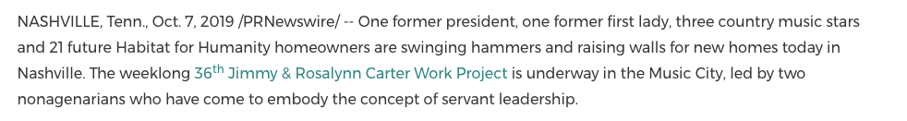
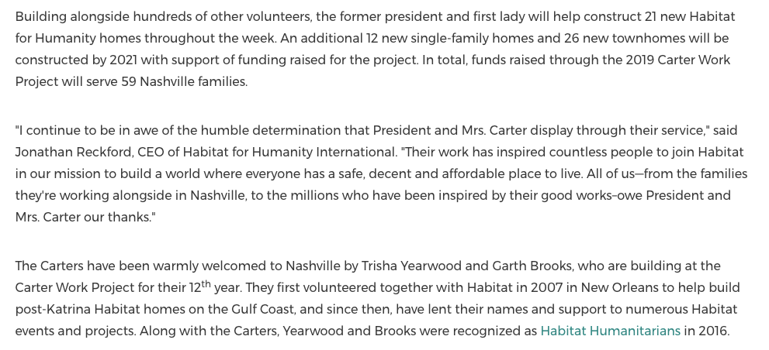
For example: press release

Slide 11
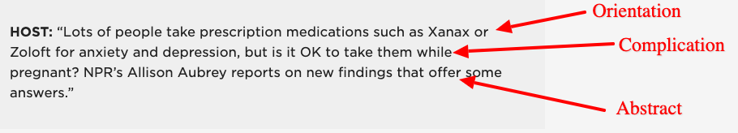
For example: radio cue (different order!)
https://training.npr.org/2017/12/06/the-journey-from-print-to-radio-storytelling-a-guide-for-navigating-a-new-landscape/#section4

Slide 12

For example: documentary
Andrew: The Problem Prince | Channel 4 Documentaries: https://www.youtube.com/watch?v=D9voR1cCpb4

Slide 13

For example: podcast
Serial | Season 01, Episode 01 | The Alibi

Slide 14

For example: podcasts
Opening mix = abstract
Intro/sting = orientation
Things Fell Apart ep.1

Slide 15

Where is the abstract?
THE BIRDCAGE and LA CAGE AUX FOLLES: The Inside Story https://www.youtube.com/watch?v=ozTjoeHy7mI

Slide 16
Identify your story’s complication

Slide 17
The complication drives your story
This is the ‘problem’ that your story is trying to solve:
A bad experience
An ambition/target
Other perspectives (especially in an update)
How to develop a skill (in a practical story)
A problem that you are exploring

Slide 18
What is your complication?
Identify potential elements in your research/transcripts* that could be your focal complication (problem/challenge)
Which one might be best?
Which allows you to do more?
Which is the most universal? Most important? Topical?
*If you need some material, use Prince Harry and Meghan Markle’s first-ever interview together

Slide 19
Identify other elements
Which part of your raw material might be a ‘result’?
Which part ‘looks ahead’ to future developments?
Which parts flesh out and ‘evaluate’ the complication?
Which parts ‘set the scene’ (orientation)
Is there anything which sums the story up (abstract), e.g. an anecdote, or something the interviewee does?
*If you need some material, use Prince Harry and Meghan Markle’s first-ever interview together

Slide 20
Identify what is missing
At this stage identify any extra elements you need to gather
Do you need to find out what happens next? (Coda)
Do you need to ask more questions about problems?
Do you need to research the wider context of the story?

Slide 21
Your abstract
is a promise

Slide 22
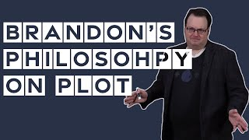
Sanderson’s 3 Promises:
Plot: What sorts of things might happen (and genre)
Tone: Dark, light, funny, serious, romantic, etc.
Character: Who is driving it

Slide 23

The promise in Star Wars

Slide 24
…in Star Wars (Baugh 2024):
Plot: “This is the "Call to Adventure" in its purest form, straight out of the Hero's Journey playbook. It's the calm before the storm, the tease of the thrills to come.”
Tone: “It sets us up for a story that's going to be epic in scope. But it also prepares us for the quieter, more introspective moments.”
Character: “This sets up a crucial part of Luke's character. Throughout the story, we see him searching for father figures, for mentors who can guide him on his path”

Slide 25
In factual storytelling this is a genre promise

Slide 26
“Genre represents an unspoken agreement between the [creator] and the reader about what to expect … [they] also influence what is included in or excluded from a story … a hard news story will not contain comments by the author.”
Broersma 2008

Slide 27
Genre promise examples
This is going to be…
An interview feature
A true crime podcast
A news story
A video explainer
A practical how-to

Slide 28
What’s the genre promise?
What’s the tone promise?
Women-only train carriages could combat the rise in sexual offences on public transport, a Labour MP has said.
BBC

Slide 29
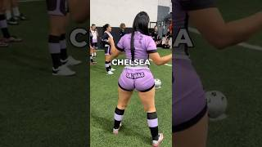
What’s the genre promise?
Things Fell Apart ep.1, ep6, s2 6

Slide 30
What’s the genre promise?
‘When I became a meme it was humiliating and hurtful’: Dua Lipa on pop, psychedelics and proving her haters wrong
Guardian

Slide 31
What’s the genre promise?
THE BIRDCAGE and LA CAGE AUX FOLLES: The Inside Story
https://www.youtube.com/watch?v=ozTjoeHy7mI

Slide 32
What’s the genre promise?
“For the last year I’ve spent every working day trying to find out where a high school kid was for an hour after school one day in 1999.”
Serial

Slide 33
What’s the genre promise?
https://training.npr.org/2017/12/06/the-journey-from-print-to-radio-storytelling-a-guide-for-navigating-a-new-landscape/#section4

Slide 34
Genre + tone promise: examples
This is going to be…
An interview feature (tone: colourful, informal)
A true crime podcast (tone: serious, mysterious)
A news story (tone: factual, objective)
A video explainer (tone: factual, chatty)
A practical how-to (tone: factual, informal)

Slide 35
What’s the tone promise?
Andrew: The Problem Prince | Channel 4 Documentaries: https://www.youtube.com/watch?v=D9voR1cCpb4

Slide 36
What is your genre?
Pitch me the type of story you are working on
What examples can you point to in the same genre?
Look at a few: what structure do they all follow? What form does the abstract take? Orientation? Complication? Coda?
They should provide a structure you can repeat

Slide 37
Genre structures
you can use

Slide 38
Two common genre structures
The inverted pyramid: for ‘update’ stories like news
WSJ feature formula/kebab: for packages and features

Slide 39
Inverted pyramid = ‘update’ stories (eg. news)
1. Something happened, where/when [ABSTRACT]
2. Context/more details: age/location; following X or leading up to Y; latest of Z etc. [ORIENTATION]
3. Reaction or meaning [COMPLICATION/EVALUATION]
4. More context/background/reaction - alternate
End: A quote, or what happens next [RESULT/CODA]

Slide 40
For example:
Women-only train carriages could combat the rise in sexual offences on public transport, a Labour MP has said.
Shadow fire minister Chris Williamson said it would be "worth consulting" on the policy after such crimes doubled in the past five years.
However, Labour colleagues have criticised the move as "normalising attacks".
Party leader Jeremy Corbyn first suggested the policy during his leadership election campaign in 2015.
Mr Williamson, MP for Derby North, highlighted figures from the British Transport Police, showing 1,448 sexual offences on trains had been reported in 2016-17, compared with 650 incidents in 2012-13.
He told PoliticsHome that women-only carriages - which have been tested in countries including Japan, Brazil and Mexico - could create a "safe space".
BBC

Slide 41
For example:
The actor Ruth Wilson has hit out at the “hypocrisy” of Hollywood for its handling of the #MeToo revelations in an interview with the Guardian.
Wilson, star of Luther, The Affair and His Dark Materials, said it was “extraordinary” to witness Hollywood shift from ignoring the abusive behaviour of leading industry figures such as the now jailed Harvey Weinstein to feigning interest.
The 41-year-old also discussed the pressure on female actors to have cosmetic surgery, labelling treatments including Botox “mad”.
On the #MeToo movement, Wilson said it was “extraordinary … to actually witness Hollywood shift like that”.
She said: “To see the survival instinct. You realise how fickle that industry is. There’s no moral backbone. People were like: ‘We’re going to have a meeting about how badly we’ve behaved and then we’ll all be fine.’ It blew my mind.
Guardian

Slide 42
*Dominant in Anglo-Saxon storytelling
“Russian stories often have more elaborate narratives, in which the main findings sometimes are not given at the top of the story, but ‘revealed’ lower down — almost as a surprise.
“But I do think there is value in the ‘Anglo-Saxon’ tradition of having a tight nut graf at the top of the story.”
Source

Slide 43
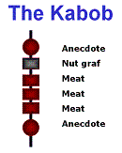
The kabob/WSJ Feature Formula = longer
1. Anecdote (case study) or incident [ABSTRACT]
2. The ‘big picture’ it is part of [ORIENTATION]
3. The problem, or obstacles [COMPLICATION]
4. What was done to tackle those [EVALUATION]
5. Where we are now, e.g. experts [RESULT]
End: Back to anecdote/incident/what happens next [CODA]
Man (2011)

Slide 44
During the 13 years that Connie Nguyen has worked in Bay Area nail salons, she's seen numerous friends and co-workers become ill. She, too, has come down with mysterious skin rashes and respiratory problems. A few years ago, experiencing shortness of breath, she went to the doctor.
"The X-ray technician asked me if I'd been smoking a long time," said Nguyen, 48. "It shocked me. I have never smoked in my life."
Amid a booming beauty industry, California's legions of nail salon workers - most of them Asian immigrant women - are being exposed to hazardous chemicals in cosmetic products, chemicals that have largely gone unregulated because state law exempts cosmetics and personal care products.
With evidence mounting that prolonged exposure to chemicals is putting these vulnerable workers at risk for a host of health problems, state Sen. Carole Migden held a legislative hearing Thursday in San Francisco to begin assessing perils in salons. Her purpose was to establish what the state can do to protect salon workers.
Anecdote
Orientation >
Complication
SFGate
Notes:
The kabob begins with a human story (sometimes called a ‘focus’ piece) before panning out.

Slide 45
During the 13 years that Connie Nguyen has worked in Bay Area nail salons, she's seen numerous friends and co-workers become ill. She, too, has come down with mysterious skin rashes and respiratory problems. A few years ago, experiencing shortness of breath, she went to the doctor.
"The X-ray technician asked me if I'd been smoking a long time," said Nguyen, 48. "It shocked me. I have never smoked in my life."
Amid a booming beauty industry, California's legions of nail salon workers - most of them Asian immigrant women - are being exposed to hazardous chemicals in cosmetic products, chemicals that have largely gone unregulated because state law exempts cosmetics and personal care products.
With evidence mounting that prolonged exposure to chemicals is putting these vulnerable workers at risk for a host of health problems, state Sen. Carole Migden held a legislative hearing Thursday in San Francisco to begin assessing perils in salons. Her purpose was to establish what the state can do to protect salon workers.
This is called the “nut graf”: the ‘big picture’ of the story
SFGate
Notes:
The kabob begins with a human story (sometimes called a ‘focus’ piece) before panning out.

Slide 46
"Every day, nail salon workers are exposed to a wide array of carcinogenic chemicals," said Migden, a San Francisco Democrat who heads the Senate's Labor and Industrial Relations Committee. She noted that some of the products routinely used in the state's thousands of nail and beauty salons are banned in Europe.
Nail salons garnered headlines in recent years after scores of customers around the state became ill from bacterial infections, many stemming from dirty footbaths after pedicures. A law, authored by then-Assemblyman Leland Yee (D-San Francisco), now a state senator, went into effect last year tightening controls and imposing penalties on salons found to be using unsanitary practices.
But even though the number of nail salons in California has more than tripled during the last two decades, little research has been done on the health effects to the state's salon workers, many of them in childbearing years, from exposure to toxic chemicals.
Evaluation: makes up around 80% of the story as we explore more about the ‘complication’ and what is being done, through quotes and facts
SFGate
Notes:
The kabob begins with a human story (sometimes called a ‘focus’ piece) before panning out.

Slide 47
Various experts testified during the packed 21/2-hour hearing at City Hall that salon technicians - many of whom work 10 hours a day, six or seven days a week - were systematically accumulating significant amounts of toxic chemicals.
"It's not just the dose that makes the poison," said Charlotte Brody, a registered nurse and executive director of Commonweal, a nonprofit health and environmental research institute in Bolinas.
"We are now beginning to see chronic asthma, dermatitis and other respiratory illnesses," said Julia Liou, representing Asian Health Services, a community health center serving Alameda County, and the California Healthy Nail Salon Collaborative. Liou said that a research project is to be started in January by Asian Health Services and the Northern California Cancer Center to study whether salon workers have a higher incidence of breast cancer.
Lam Thi Le, 58, a mother of two who lives in Oakland, testified that in 1992, two years after she began working as a manicurist, she was diagnosed with thyroid problems; a decade later she was diagnosed with breast cancer. She quit, Le said, "after 12 years of sacrificing my health to make a living."
George Alexeef, deputy director of the state's Environmental Health Hazard Assessment, which publishes a list of chemicals known to cause cancer or reproductive toxicity, testified that toluene and formaldehyde - contained in some nail salon products - are among the hundreds of substances identified by his office. He said the two chemicals cause health effects ranging from fatigue and headaches to respiratory irritations and cancer.
"We have more chemicals than we can possibly test or evaluate," said Alexeef, whose office is part of the state Environmental Protection Agency.
Kristy Underwood, executive officer of the state Board of Barbering and Cosmetology, which regulates the salon industry, said there are only 16 inspectors responsible for overseeing the state's 35,000 salons. The state has some 94,000 licensed manicurists.
"It is physically impossible to reach all the salons," she said.
Evaluation: makes up around 80% of the story as we explore more about the ‘complication’ and what is being done, through quotes and facts
SFGate
Notes:
The kabob begins with a human story (sometimes called a ‘focus’ piece) before panning out.

Slide 48
Also testifying was Nhung Pham, 55, who works at Nail Today in Oakland. She is part of an informal group of salon workers brought together by Asian Communities for Reproductive Justice.
"We share stories about our aches and pains, and some have even shared stories about miscarriages," she said.
Many of the workers speak little or no English, impeding "our ability to understand the health and safety inspections and citations process," Pham said.
Migden said she plans to introduce legislation on the matter in the coming year.
Result:
Where are we at now? Penultimate* lines.
This story lacks one and so it feels like it ends too suddenly.
*Penultimate = the line before the last line
SFGate
Notes:
The kabob begins with a human story (sometimes called a ‘focus’ piece) before panning out.

Slide 49
Also testifying was Nhung Pham, 55, who works at Nail Today in Oakland. She is part of an informal group of salon workers brought together by Asian Communities for Reproductive Justice.
"We share stories about our aches and pains, and some have even shared stories about miscarriages," she said.
Many of the workers speak little or no English, impeding "our ability to understand the health and safety inspections and citations process," Pham said.
Migden said she plans to introduce legislation on the matter in the coming year.
Coda:
Looking forward/what happens next. Just one line is enough. Can be a quote.
SFGate
Notes:
The kabob begins with a human story (sometimes called a ‘focus’ piece) before panning out.

Slide 50
What’s the ‘anecdote’?
Then: what’s the orientation? The complication?
Andrew: The Problem Prince | Channel 4 Documentaries: https://www.youtube.com/watch?v=D9voR1cCpb4

Slide 51
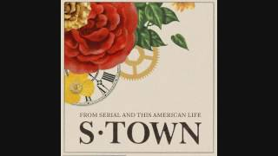
What’s the ‘anecdote’?
Then: what’s the orientation? The complication?
https://www.youtube.com/watch?v=npQdUjq_-QE&list=PLYApml9ZfRZ7LnJU7Z_Y2Ll9DnMkT0qrz&index=1

Slide 52
…In an interview/package
Standfirst or cue (ABSTRACT)
A colour-full opening + character (ABSTRACT/ORIENTATION)
Introduce the problem/challenge (COMPLICATION)
Explore that in 3+ sections (EVALUATION)
Where are we now? (RESULT)
What happens next (CODA)

Slide 53
The standfirst/cue:
As farmers plan a new protest over plans to leave the EU without a deal, Jane Smith looks at the impact of Brexit on farming…
It’s 10 years since Alt-J released XX. Mo James spoke to the band about a decade at music’s cutting edge

Slide 54
In the wake of the Lionesses’ success, knee injuries are at epidemic levels in the women’s game. From boots designed for men to unequal training regimes, how much are sexist double standards to blame?
t happened about 10 minutes into a Crystal Palace v Lewes match. There was a hum of excitement in the Dripping Pan, Lewes FC’s football stadium. Ashlee Hincks ran down the wing, received the ball and went to cross it to a teammate. She planted one foot down and prepared to strike the ball with her other foot. But her boot got stuck in the grass; her body kept turning. “Everyone says they hear a pop or a crack. I heard a crack,” she says now. The pain was severe, and Hincks had to be carried off the pitch. She sat in the ambulance praying it was a dislocated kneecap.
It was 8 September 2019. Hincks, then 30, was a striker for Crystal Palace. She had scored more than 25 goals since she had arrived from Millwall Lionesses the year before and had been named player of the season. But now what she dreaded most had happened: she had torn her anterior cruciate ligament (ACL).
Standfirst (abstract)
Anecdote
(abstract)
Orientation
Complication
(small picture)
Guardian
Notes:
The kabob begins with a human story (sometimes called a ‘focus’ piece) before panning out.

Slide 55
For complex, long-misunderstood reasons, women suffer this injury far more often than men. It upended the Women’s World Cup last year when two of England’s star players, Leah Williamson and Beth Mead, were out with torn ACLs. England weren’t alone. Research by @aclwfc, the fan-led resource on ACL injuries, showed that 25-30 players globally missed the tournament, including Ballon d’Or nominee Vivianne Miedema. At the start of this season – the Women’s Super League (WSL) returns next weekend – the ACL injury list includes Australia and Chelsea striker Sam Kerr; USA and Chelsea striker Mia Fishel; Arsenal midfielder Victoria Pelova; Scotland forward Fiona Brown (for a fourth time); and AC Milan and Scotland midfielder Christy Grimshaw.
The “nut graf”: (complication: ‘big picture’)
Guardian
Notes:
The kabob begins with a human story (sometimes called a ‘focus’ piece) before panning out.

Slide 56
Players know what it means: their career is at stake. For a European champion this is bad news. But the growth in the number of grassroots players means the issue is becoming more urgent. Almost 1,500 new teams were created after the Lionesses won the Euros in 2022, according to England Football. More than 1,000 new female players joined Surrey FA alone. And now these women are tearing their ACLs in alarming numbers.
“There’s no support for injured women. They’re completely on their own,” says Emma Eaton, football development officer (female lead) for Surrey FA, which represents around 8,500 women and girls in grassroots teams. “If you’re a nurse, how do you do your shifts? If you have kids, how do you drive them to school?”
The big question is, why is this happening to so many female players? The quest for answers stretches from second-rate pitches and ill-fitting boots to misogyny in medicine and narrow attitudes to women’s bodies. In other words, in a field dominated by men, torn ACLs are “not just about football”, says Dr Katrine Okholm Kryger, associate professor in sports rehabilitation, St Mary’s University, Twickenham. “They’re about equality.”
Evaluation: explore more about the ‘complication’ and what is being done, through quotes and facts
Guardian
Notes:
The kabob begins with a human story (sometimes called a ‘focus’ piece) before panning out.

Slide 57
When Hincks finally had surgery on the NHS, six months after she fell to the ground, she arrived with her knee looking like an explosion site. Crystal Palace had discouraged her from fundraising for private surgery, because “it would make the club look bad”. (The club say the people responsible for the women’s team at the time no longer work there.) She returned to fitness in December, nine months after the surgery. She played a few matches for Crystal Palace, but the club didn’t renew her contract. “I was top goal scorer, player of the year, and to be easily forgotten just by doing your ACL was really frustrating. I still had a lot to give,” she says. Her new team, AFC Wimbledon Women, finished last season as champions of Division One South East and were promoted to the Premier Division South.
The procedure to harvest a tendon has left its mark. “My calf is tight, my hamstring tight. I tore my achilles last year. Nothing is working quite right in that left leg,” Hincks says. “I can’t describe how difficult an injury it is to come back from. But this just seems to be what being a female footballer entails now.”
Result:
Where are we at now? Returns to the anecdote at the start
Coda:
Forward-looking. How else could it end? Can it be stronger?
Guardian
Notes:
The kabob begins with a human story (sometimes called a ‘focus’ piece) before panning out.

Slide 58
Now, let’s apply those...

Slide 59
Do you remember Chelsea physiotherapist Ava Carero who became popular on social media because all Chelsea fans were in love with her?
She was a key doctor for the english team but an incident with Eden Hazard cost her her job.
Hazard was injured as usual and Ava was doing her job she rushed to help him but this annoyed Jose morinho because as soon as the doctors entered the field player had to leave the pitch.
Mourinho's anger didn't stop there and he decided to expel Ava From the Bench during training sessions.
It was the end of Eva Caro's career with the club — but that's not all. False rumors were also circulating about her private life.
All this destabilized her career but she didn't give up.
Chelsea offered her a large sum of money to keep quiet but she refused the money
and took Chelsea to court.
She received more money and now owns an English soccer team.
Imagine ending up out of work because of a minor misunderstanding with your employees but then having so much mental space to turn the situation to your advantage.
Winning her case wasn't enough for her taste so she went much further by realizing her dream of owning a club.
The strength of this woman is simply exceptional and an example to follow in the Working World
What elements does this story have? What could you cut?

Slide 60
The result…

Slide 61
This is what you should know.
Many structures are standardised and generic. They help us and readers to organise information and set expectations
The kabob (longer stories) and inverted pyramid (shorter updates) are most common
Look at examples similar to what you want to achieve and mirror their structure and conventions (eg standfirsts)

Slide 62
What happens next?
(Coda)

Slide 63
Directed reading/listening:
MA DJ: Heravi (2022) Storytelling Structures in Data Journalism
MA MP: Listen: Framing The Story
See Moodle for optional reading including Murphet - Narrative and Voice

Slide 64
Directed study: keep writing
Draft a story (MADJ: news or feature; MAMP: interview or profile)
Check the structure: does it have all Cortazzi’s elements?
Analyse examples of stories in the genre you are using
Identify if they use a kabob or inverted pyramid. Adjust your draft to follow the same structure.
Share it with me before the next class!

Slide 65
Questions?

Slide 66
Bonus:
More structures and other things you can do

Slide 67
Structure within structure
Listen to Things Fell Apart ep.1, ep6, s2 6
As a longer narrative, it has multiple stories.
Each one has an abstract, orientation, complication, etc. See if you can identify them.
But the overall episode has this structure too. See if you can identify how an overarching ‘complication’ is introduced which the individual stories then explore.
Put another way, the ‘evaluation’ phase of the episode can be broken down into mini-narratives.

Slide 68
Inverted pyramid vs feature structure
Look at this feature based on an interview with an actor
Compare this news story (inverted pyramid) also based on it

Slide 69
Transcript > feature
Here’s an unedited transcript of an interview with a musician
Here’s the edited interview feature
Identify which quotes were used — and which weren’t. Why?
Identify where quotes were used — and why

Slide 70
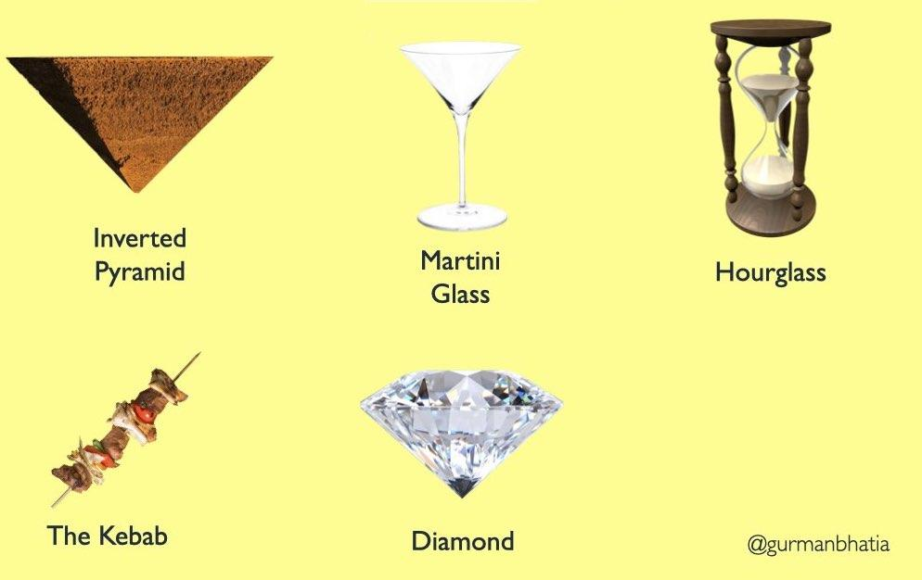
https://www.gurmanbhatia.com/talk/2021/03/09/stories-structure.html

Slide 71
The ‘inverted trapezoid’
“There’s some narrowing of import from the bang of the lead to a quieter, more speculative conclusion, but it’s not the pointy whimper of the pyramid. The trapezoidal story introduces compelling material throughout. If readers depart after the first 150 words, though, they’ve still gotten the gist.”

Slide 72
The ‘inverted trapezoid’
What happened and in what context?
Why does it matter?
Answers to burning questions, such as:
How does it work?
Who did it impact?
Why did it happen?
What’s the backstory?
What’s next?

Slide 73
The drop intro
1. A teasing first paragraph [ABSTRACT]
2. What led up to this [ORIENTATION]
3. ‘But’ - the new thing [COMPLICATION]
4. Quotes, context to that [EVALUATION]
5. Where we are now, e.g. experts [RESULT]
End: Back to anecdote/incident/what happens next [CODA]

Slide 74
He is the toast of New York, of London – and of a small village called Llanddewi Rhydderch.
Just four months after Josh Wardle invented the wonderfully simple and soothing puzzle Wordle, he is a megastar in the world of games and is a great deal wealthier after the New York Times acquired his creation for a seven-figure sum.
But back in his home village in south-east Wales, which has a church, a chapel, an ancient yew tree and not much else, Wardle’s family expressed quiet joy at their son’s success, and also, perhaps, a little bemusement.
“We’re very proud but it won’t change him at all,” said his father, Christopher, a farmer. “He’s not interested in the money side of things. He just likes creating. This all got so big so quickly.”
https://www.theguardian.com/media/2022/feb/01/incredible-wordles-welsh-beginnings-to-the-new-york-times

Slide 75
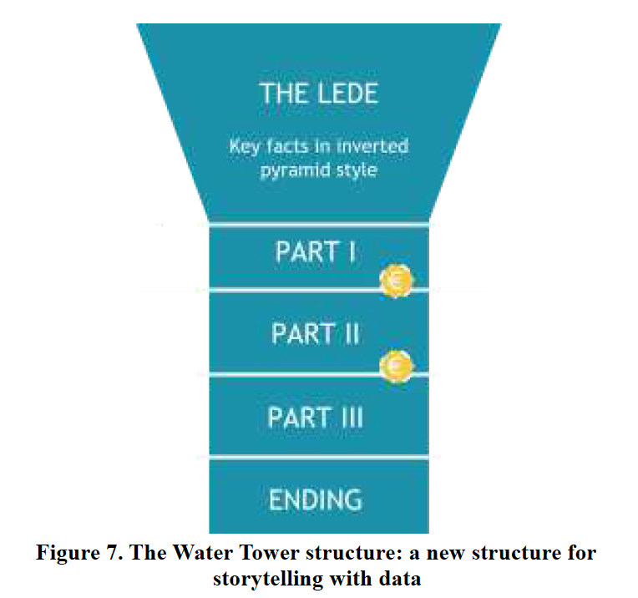
The water tower
Heravi (2022) Storytelling Structures in Data Journalism: Introducing the Water Tower structure

Slide 76
9 principles of better stories
Connell-Waite, 2024
Transformational
Capture the imagination
Tell the truth
Measurable outcomes
Emotional
Use strong verbs and short sentences
Surprising
Understandable
Inspire action

Slide 77
How would you order these?
You’ve been working on a TV drama for 6 months. This week you are filming a big fight scene and so many props have been broken that you’ve had to order in more. The director has 3 more days and will then move to a new location for the next shoot. You’ve been asked to write ‘the story’ for the drama’s behind-the-scenes blog.

Slide 78
How would you order these?
You’ve been to an conference on climate change organised by Google. The first speaker talks about how they overcame censorship by collaborating across borders. The second speaker talks about how climate change coverage has changed at the BBC. You’ve been asked to write a story about the event - how might you structure it?

Slide 79
How would you order these?
You work on a breakfast radio show. Today’s main guest - a singer whose album comes out tomorrow - arrived late, slurred her words, insulted a caller, and swore on air (the presenter had to apologise). The interview was cut short and the presenter apologised again afterwards. Complaints were made to Ofcom. You’ve been asked to write ‘the story’ for the station website.

Slide 80
Make a list:
1. What’s the abstract? (the story in a nutshell)
2. What’s the orientation? (Where, who, when)
3. What’s the complication?
4. What happened next? (evaluation)
5. What’s the ultimate result?
6. What might you need for a coda?

Slide 81
More detail in
the workshop brief on Moodle

